Slide 1

Free Python and Django workshop
for women at EuroPython, July 2015

Slide 2
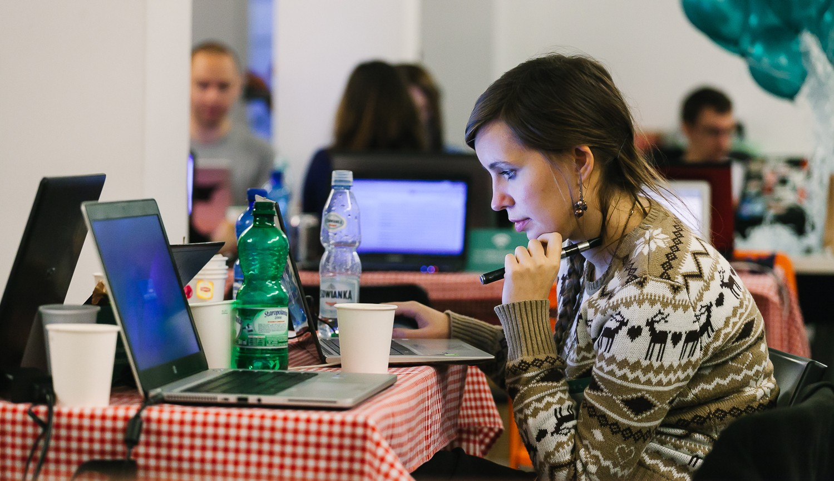
About
20th July 2015
Bilbao, Spain
Django Girls is an initiative that is aiming
to introduce 30 women who've never coded before to the world of technology and increase the diversity. On the first day of EuroPython in Bilbao, we’re going to organize an one-day workshop and invite girls from all over the world to join us and learn how to build the internet using HTML, CSS, Python and Django.

Slide 3
Target
Date & place
Supporters
30 women who never programmed before but are motivated to get into field, and who would share their experience with others
Full day, 20 July 2015 at EuroPython, one of the biggest Python conferences in Europe, hosted this year in Bilbao, Spain.
We have already partnered with 10 awesome coaches and with EuroPython who will host the workshop and our Django Girls booth at the conference.

Slide 4
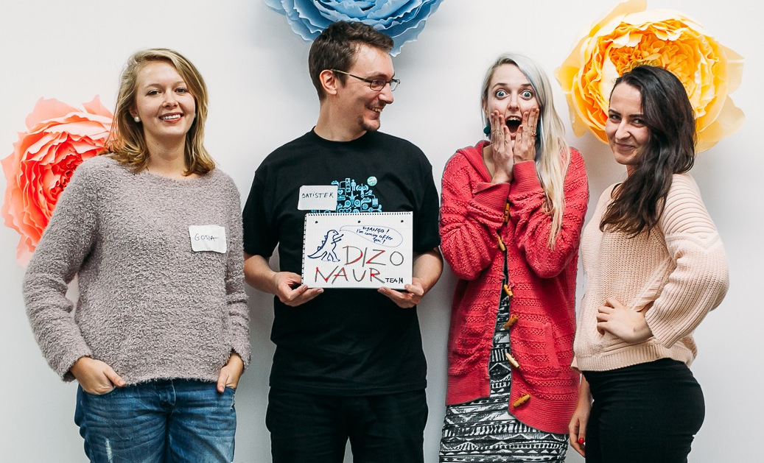
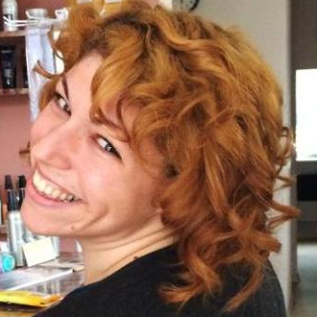
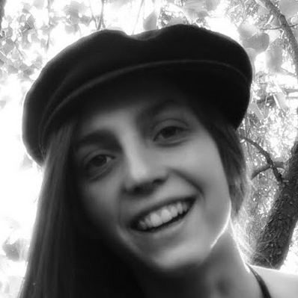
Team
Django Girls EuroPython 2015 is organized by Mikey Ariel and Petr Viktorin from Brno, Czech Republic. Mikey graduated from the first Django Girls workshop at last year's EuroPython, and co-organized with Petr and Lenka Moutelikova the first Django Girls Brno workshop in February 2015. Both working at Red Hat, Mikey is also a community lead for Write the Docs EU and Petr is one of the main coaches at PyLadies CZ, as well as an experienced Django Girls coach and coach-herder!
@thatdocslady
@enigmatahari

Slide 5

SPREAD THE WORD!
We’re looking for kind souls and organizations that support the goal of bringing more women into technology to help us.
Reaching to the local communities is the most effective way to encourage women to try out programming. Many women simply have no idea that they can pursue these fields, and among those who do, many women do not feel that they are deserving or capable of trying it out.
Our goal is to change this mentality, help women conquer their fears and give them a friendly, inclusive, and supportive environment to explore the world of technology.

Slide 6
SPREAD THE WORD!
Here are some ways you can help:
Face 2 Face
Website/Email
Social Media
Mention our workshop to all the women you know!
Share the workshop at your local meetup / company meeting
Write about us on your website
Send an email to your community or employees
Follow/retweet @djangogirlsbrno
Blog about us
Share our website on Facebook and Google+

Slide 7
Thank you! ♥
djangogirls.org/brno
@djangogirlsbrno
Get in touch:
brno@djangogirls.org

